Slide 1
Drupal and Microsoft Azure Together in Harmony

Slide 2
About Me
Worked for Oregon Tech for 18 years
Full-stack developer working primarily in the Microsoft world (Azure, .NET, etc.) but comfortable with Linux and semi-comfortable with PHP also

Slide 3
Assumptions
You like for your website to serve pages quickly
Site deployment should be easy and fast
Your organization has some vested interest in leveraging Microsoft Azure
You all know more about Drupal than I do
I am more of a Microsoft fanatic than you are

Slide 4
What I'm Hoping You Get Out of This
A greater ability to leverage your existing infrastructure
Learn how to configure your website so it runs awesome in Azure
Learn how to manage the shame of doing Linux development in a Windows

Slide 5
How My Drupal/Azure Journey Began
Started with a .NET based CMS (Sitefinity)
Marketing team hired a contractor for a redesign. That contractor specialized in Drupal. Of course, they recommended we make the switch.

Slide 6
Options for Hosting Our New Site
Hosting Provider – Base cost was about double what we were paying to host existing site, and it did not support multi-site. Additional sites were additional cost
Azure Virtual Machine - Maintenance/management overhead
Azure App Service - Cost effective and low maintenance

Slide 7
My Arch Nemesis
It’s important to have someone or something to compete against when striving to make improvements.
Your arch nemesis does not have to know that they are your arch nemesis.
As my opponent, I chose:

Slide 8
Microsoft Azure App Service
App Service is a PaaS offering allowing you to spend less time managing infrastructure.
Platforms Supported
Linux
Windows
Scalability
Services can be scaled up or out with only a few clicks or through API calls
Services can be scaled automatically by setting up resource utilization thresholds
Deployment
Upload using WebDeploy or SFTP
Push to internal git repository
Pull from external git repository
Push to a Docker repository which is pulled to the service

Slide 9
Initial Decisions
Develop in Windows Environment
Run Drupal in Windows App Service
Use git for deployment to app service local repository
Use the Varnish Docker Image for Caching
Use the Azure Database for MariaDB service

Slide 10
Initial Decisions for Development
Visual Studio Code as the IDE
PowerShell for the command line tools (e.g. Composer, PHP, etc.)
Azure DevOps as the primary code repository, but the code would be individually pushed to different Web Apps instances (production/staging/dev)

Slide 11
Environment Snapshot 1
Varnish
Azure App Service for Linux
(Docker Deployment)
Drupal
Azure App Service for Windows
(Local Git Deployment)
MariaDB
Azure Database for MariaDB
Docker Repo
Azure Container Registry

Slide 12
An Unexpected Change of Plans
After running our site in a Windows App Service for about a year, Microsoft announced it would NOT be supporting versions of PHP past 7 in App Service for Windows.

Slide 13
Moving to Linux: Should have started here
Okay, so we're moving to a Linux app service then.
Fortunately, this ended up being pretty easy.
Created a new App Service Plan for Linux
Created a new Web App
Modified settings.local.php, to change Windows paths to Linux paths
Codebase was the same, but now we can take advantage of symlinks

Slide 14
Environment Snapshot 1b
Varnish
Azure App Service for Linux
(Docker Deployment)
Drupal
Azure App Service for Linux
(Local Git Deployment)
MariaDB
Azure Database for MariaDB
Docker Repo
Azure Container Registry

Slide 15
Code Deployment
git push www master
…
… …
… … …
18 minutes later…

Slide 16
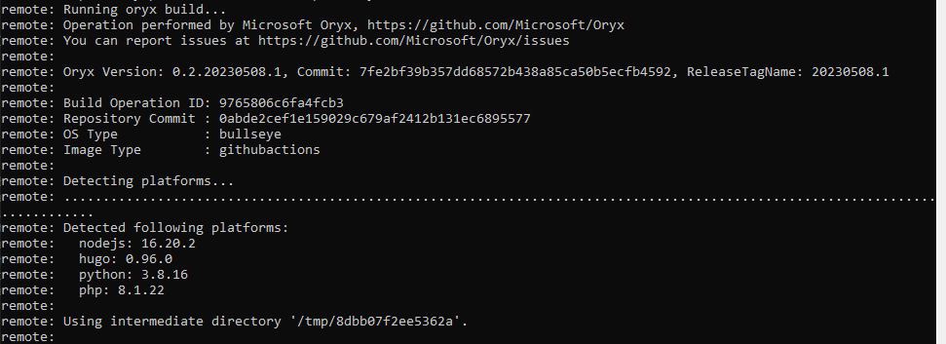
Why is Deployment Slow?
It ran a build process against the source and ran composer?
Cool, but unnecessary. Everything I needed was already in the repository

Slide 17
Web App (Code Deployment)
Let's Disable the Build Process

Slide 18
Initial Configuration vs Build-Disabled Deployment

Slide 19
Web App (Code Deployment)
Okay, the build is no longer taking place. What is taking so long now?
Here's what is taking place:
Git repo is pushed to remote
Files are being copied from /home/site/repository to /home/site/wwwroot
This also seems unnecessary…

Slide 20
Web App (Code Deployment)
Let's cut out the intermediate folder and tell it to deploy straight to the final location

Slide 21
Initial Configuration vs Build Disabled Deployment Time
Initial Configuration (Deploy after change) | Build Disabled | In-place Repository Path (First Deploy)
18 minutes | 29 minutes | 9 minutes

Slide 22
Initial Configuration vs Build Disabled Deployment Time
Initial Configuration (Deploy after change) | Build Disabled (First Deploy) | In-place Repository Path (First Deploy) | In-place Repository Path (Deploy after change)
18 minutes | 29 minutes | 9 minutes | <1 min

Slide 23
Web App (Code Deployment) - Success!

Slide 24
Deployment Works, but the Site Doesn't :(
So What Now?
The default site path configuration is /home/site/wwwroot, but I actually need it to be /home/site/wwwroot/web
Updated the configurations for:
NGINX (/etc/nginx/sites-enabled/default and /etc/nginx/nginx.conf)
PHP-FPM (/usr/local/etc/php-fpm.d/www.conf)
The site is up and running!

Slide 25
What Happened to my Site?
BUT After pushing a change to the site, my configurations are gone!
Why?
An Azure app service is effectively a container with a semi-remote storage location shared between all instances (if the app is scaled out).
/home in a Linux app (or D:\home\ in a Windows app) points to a shared storage location used by all instances of the app.
Anything outside of this path will be erased/reset after application restart
How do we persist these changes?

Slide 26
Persisting Your Server Configurations
Make the updates to your config files (www.conf, nginx.conf, sites-enabled/default, etc.)
Store them in your project repository in a folder of your choosing, like server_config
Create a script to copy the files to the appropriate locations, examples
server_config/prod/azure-startup.sh
cp /home/site/wwwroot/server_config/prod/nginx-global.conf /etc/nginx/nginx.conf
cp /home/site/wwwroot/server_config/prod/nginx-server.conf /etc/nginx/sites-enabled/default
cp /home/site/wwwroot/server_config/prod/php-fpm.conf /usr/local/etc/php-fpm.d/www.conf

Slide 27
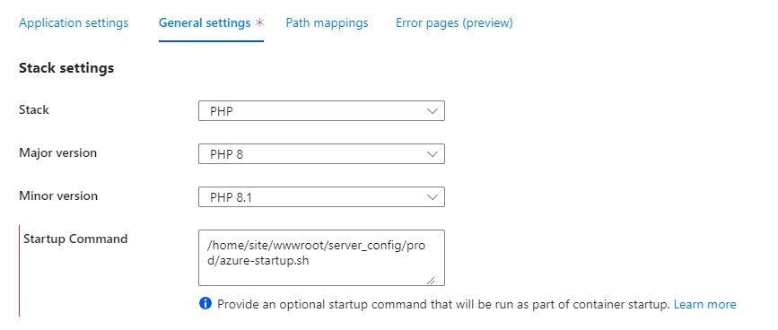
Running a Task at App Startup
Azure App Service Configuration

Slide 28
Site is Running, and Can Persist Restarts

Slide 29
First Task: Content File Storage
At this point in time, the web app is still storing content files at
/home/site/wwwroot/web/sites/default/files
This makes me a little uncomfortable because:
It's difficult to back up, SFTP is really the only way to access the files
Tied directly to the app service, which is not very agile if architecture changes
Uses shared semi-local storage for the app which is not reusable if the files need to be accessed by anything else

Slide 30
Azure Storage Options
Only Azure Files storage (as opposed to Blob storage) supports read/write operations in App Service for Linux
There is a Standard Tier and a Premium Tier. The cost difference was negligible considering the small amount of content
After testing, the Premium tier performed better (as expected) so it was selected

Slide 31
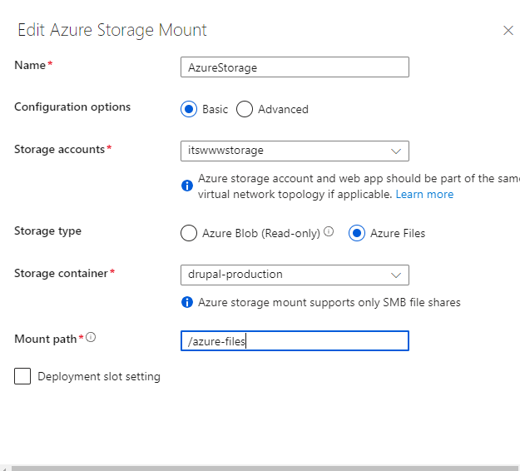
Adding Storage to Your App

Slide 32
Environment Snapshot 2
Varnish
Azure App Service for Linux
(Docker Deployment)
Drupal
Azure App Service for Linux
(Local Git Deployment)
MariaDB
Azure Database for MariaDB
Docker Repo
Azure Container Registry
Azure Premium File Storage

Slide 33
Web Pages are Faster, but Not Fast Enough
After testing database latency and everything else I could think of, another thought came to me. The site source is running out of /home/site/wwwroot . That is REMOTE STORAGE as far as the app is concerned.
This issue would not affect most software running in Azure, but Drupal is not most software. It does a lot of read/scan operations that can greatly impact performance
Within a running web app, I copied /home/site/wwwroot to a file location local to the app, /usr/local/wwwroot . I reconfigured and restarted NGINX, and….
It was significantly faster!

Slide 34
Moving the Site to Local Storage
I now had a way to speed the site up…maybe
Problem: Copying the files local would not persist through application restarts
Solution:
Copy the files at application startup. The following was added to my startup script
#Make a local drive location for storing Drupal
mkdir /usr/local/wwwroot
#Copy all of the web files from shared storage to local
cp -R /home/site/wwwroot/* /usr/local/wwwroot
#Link drush to the final location. Drush will not be available until this has been run
ln -s /usr/local/wwwroot/vendor/drush/drush/drush /usr/sbin/drush

Slide 35
Moving the Site to Local Storage(cont'd)
New Problem: The copy operation takes 8-9 minutes, during which time the application would be unavailable
Solution:
Start the web server immediately, while simultaneously copying the files.
Then, update the configuration files and restart the web server.
#Replace the old site path with the new site path in the NGINX config
sed -i -e "s/\/home\/site\/wwwroot\//\/usr\/local\/wwwroot\//" /etc/nginx/sites-enabled/default

Slide 36
Average Page Load Times
 | Initial Configuration | Updated Configuration
Home Page (Unauthenticated) | 0.1825s | 0.1567s
Home Page (Authenticated) | 2.277s | 3.05s
Available Updates Report | 4.465s | 2.711s
Content Admin Page | 1.821s | 1.76s
Modules Admin Page | 8.78s | 7.303s

Slide 37
Web App (Load Times) - Success!

Slide 38
Front-end Load Times - Varnish
Varnish was great at serving the pages faster, but it still had some major drawbacks:
On-the-fly configuration was not possible. Changing a setting required redeploying the container
It was only a single server in a single datacenter.
Modifications had to be made by way of a specially formatted file (default.vcl), which required extra effort to learn how to configure
Response times were still much slower than what I saw from Pantheon

Slide 39
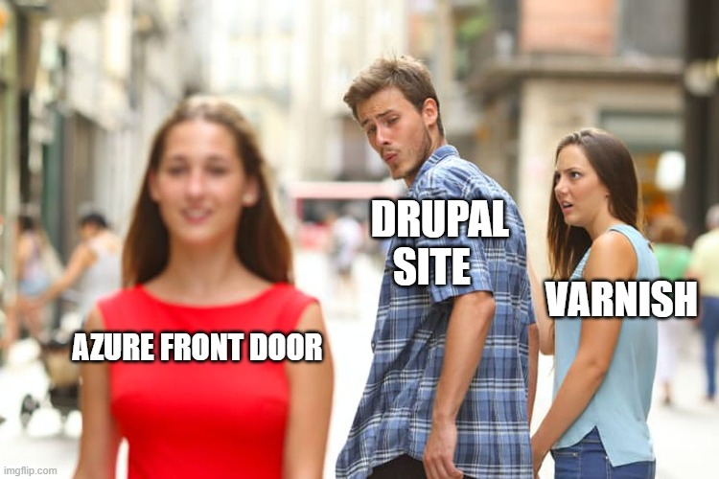
Time to Switch?

Slide 40
Azure Front Door
From Microsoft: "Azure Front Door is a modern cloud content delivery network (CDN) service that delivers high performance, scalability, and secure user experiences for your content and applications."
It is a global CDN
It lets you do all of the configuration from a GUI, and changes take effect (nearly) immediately.
Automatically manages certificates for your endpoints
It's fast, response times were cut by at least 100% compared to Varnish

Slide 41
Environment Snapshot 3
Azure Front Door
Drupal
Azure App Service for Linux
(Local Git Deployment)
MariaDB
Azure Database for MariaDB
Azure Premium File Storage

Slide 42
One Caveat with Front Door
Problem:
If you are not hosting your DNS in Azure, Azure Front Door can't handle your Apex domain (e.g. oit.edu)
Solution:
Web apps do not have this problem. You can point your apex domain at a standard App Service for Linux. Create a simple .NET Core application to redirect all traffic to the "www" version of your site.
using Microsoft.AspNetCore.Rewrite;
var builder = WebApplication.CreateBuilder(args);
var app = builder.Build();
var options = new RewriteOptions()
.AddRedirect("(.*)", "https://www.oit.edu/$1", 301);
app.UseRewriter(options);
app.Run();

Slide 43
Conference Proposal Submitted
At this point, I was pretty excited about my successes
I submitted my proposal to present what I had learned
Deployment was fast, the site was stable but…

Slide 44
I wasn't happy with having a task at startup to copy files
and still felt that pages could load faster

Slide 47
I had already been using Docker previously for Varnish, and having the self-contained application was great
Would docker be a good fit for something like Drupal that would be frequently updated?
What about the config files like settings.local.php that have private data?

Slide 48
Separation of Concerns
One of the big selling points of Docker is the ability to separate out different parts of your infrastructure to make them easier to update/manage.
We'll run two containers:
NGINX - Serves static resources and acts as frontend proxy for PHP-FPM
PHP-FPM - Runs PHP scripts

Slide 49
Docker Setup
Project Restructuring
/drupal_src - Drupal which was previously at the root of my repository
/nginx - Configuration files specific to NGINX
/php-fpm - Configuration files specific to PHP-FPM
/Dockerfile.nginx - Instructions for building the docker image for NGINX
/Dockerfile.phpfpm - Instructions for building the docker image for PHP-FPM
/entrypoint-nginx.sh - Startup file configured in Dockerfile.nginx. Set up symlinks, start SSH
/entrypoint-php-fpm.sh - Startup file configured in Dockerfile.php-fpm. Set up symlinks, start SSH, store environment variables

Slide 50
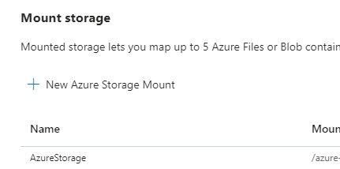
Configuring Azure for Docker Compose
#yaml config in Azure Deployment Center
version: '3.9'
services:
nginx:
image: <registry name here>.azurecr.io/ot-drupal-nginx
ports:
- '80:80'
depends_on:
- php-fpm
volumes:
- AzureStorage:/azure-files
php-fpm:
image: <registry name here>.azurecr.io/ot-drupal-php-fpm
volumes:
- AzureStorage:/azure-files
cap_add:
- ALL

Slide 51
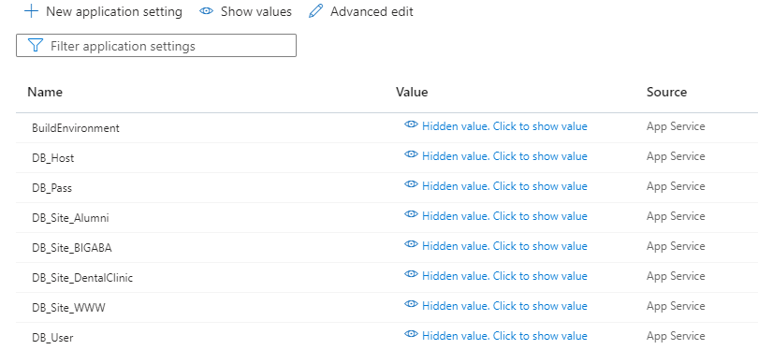
Fixing the Settings.local.php Problem
We don't want to store secrets in our git repo
Instead, we will use the app configuration in the Azure Portal to inject these settings into the environment
$databases['default']['default'] = array (
'database' => getenv('APPSETTING_DB_Site_WWW'),
'username' => getenv('APPSETTING_DB_User'),
'password' => getenv('APPSETTING_DB_Pass'),
'prefix' => '',
'host' => getenv('APPSETTING_DB_Host'),
'port' => '3306',
'namespace' => 'Drupal\\Driver\\Database\\mysql',
'driver' => 'mysql',
);

Slide 52
Environment Snapshot 4
NGINX
Container
PHP-FPM
Container
Azure Front Door
Drupal
Azure App Service for Linux
MariaDB
Azure Database for MariaDB
Docker Repo
Azure Container Registry
Azure Premium File Storage

Slide 53
Average Page Load Times
 | Initial Configuration | Updated Configuration | Docker
Home Page (Unauthenticated) | 0.1825s | 0.1567s | 0.1547s
Home Page (Authenticated) | 2.277s | 3.05s | 2.439s
Available Updates Report | 4.465s | 2.711s | 2.04s
Content Admin Page | 1.821s | 1.76s | 1.559s
Modules Admin Page | 8.78s | 7.303s | 4.663s

Slide 54
I DID IT!

Slide 55
Running Linux Software in Windows
Anyone who has ever tried running Linux software in Windows with tools like Cygwin knows that:
At its worst, it doesn't come anywhere near working and is a nightmare to set up
At its best, it mostly works, and is only painful to set up
+
= ?

Slide 56
Windows Subsystem for Linux (WSL)
Lets you run a Linux command-line environment directly in Windows
WSL as well as distributions such as Ubuntu can be installed easily from the Microsoft Store
Supports most standard console applications
Shares network with Windows
Limitations:
Only certain Linux distros are available
Does not support Linux filesystems (e.g. ext4)
Does not easily support Linux Window Managers (why would you need to in Windows?)

Slide 57
Development Environment (cont'd)

Slide 58
Revised Decisions for Development
Visual Studio Code as the IDE (opening files directly in WSL)

Slide 59
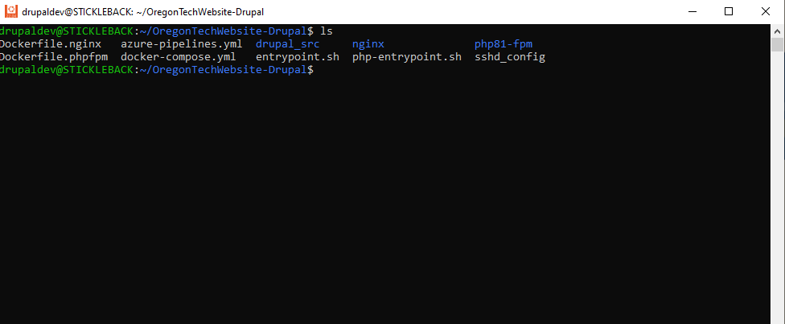
Revised Decisions for Development
Bash for the command line tools in WSL window (e.g. Composer, PHP, etc.)

Slide 60
Revised Decisions for Development
Azure DevOps as the primary code repository.
Based on which branch is pushed, it will build the Docker images and push to a different container repository, or different tag
The Web Apps will automatically pull new images

Slide 61
Azure DevOps Configuration Basic Configuration
You will need to use a self-hosted build agent to build the docker images. This can be a VM in Azure that is only turned on when you need it. Microsoft has pretty good documentation on setting this up.
The following file must be at the root of your repository. It defines the build process
azure-pipelines.yml
trigger:
- master
- development
pool:
name: 'otm-app-01 Agent'
workspace:
clean: all
← The branches that will cause the pipeline to run
← The build agent pool to run this pipeline
← Clean up after yourself

Slide 62
Azure DevOps Configuration Build Container
azure-pipelines.yml (cont'd)
##############################################################
#Build for Production (master) branch
##############################################################
- task: Docker@2
displayName: Build NGINX Image
condition: and(succeeded(), eq(variables['Build.SourceBranch'], 'refs/heads/master'))
inputs:
containerRegistry: 'Azure Container Registry (Production)'
repository: 'ot-drupal-nginx'
tags: |
latest
command: 'buildAndPush'
Dockerfile: '**/Dockerfile.nginx'
← Only run for specific branch
← Some configuration necessary to link Azure Container Registry to DevOps
← Dockerfile to build

Slide 63
Azure DevOps Configuration Clean Up
azure-pipelines.yml (cont'd)
##############################################################
#Clean up build agent
##############################################################
- task: CmdLine@2
displayName: Clean Up NGINX
condition: and(succeeded(), eq(variables['Build.SourceBranch'], 'refs/heads/master'))
inputs:
script: 'docker rmi -f otcontainerreg.azurecr.io/ot-drupal-nginx:latest'
Container to clear out of build agent
IMPORTANT: If you don't do some cleanup on the build agent, a few builds of the containers will quickly run it out of disk space

Slide 64
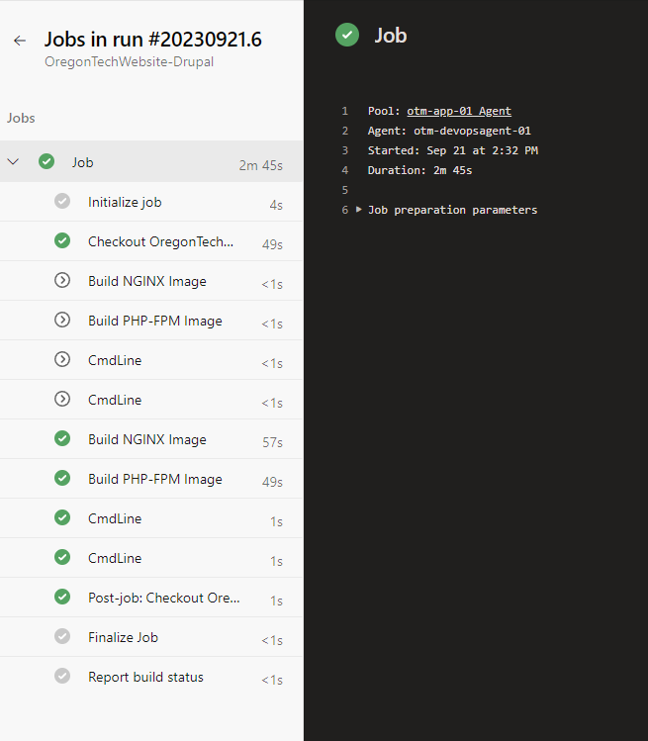
Azure DevOps Build
When you run your build pipeline, you get full visibility into each of the steps

Slide 65
Azure Container Registry

Slide 66
Continuous Integration / Continuous Delivery
We have attained CI/CD for our Drupal Website in Azure

Slide 67
Cost Breakdown (Single Environment)
Azure Service | Cost/mo | Cost/yr
Front Door | ~$100 | ~$1200
App Service for Linux | $127.75/mo | $1533
Database for MariaDB | $163.30/mo | $1959.60
Azure File Storage | ~$40 | $480
Total | $431.05 | $5172.60

Slide 68
The Final Showdown
Did We Beat Pantheon for Backend Speed?
Sadly, not yet. Most backend pages come in at about 1 second slower than Pantheon.
Did We Beat Pantheon for Frontend Speed?
Not sure. Our home page loads a couple seconds faster on Azure, but I’m not sure if their CDN is in play for unpaid dev accounts.
Did We Beat Pantheon for Cost and Flexibility?
You bet we did!

Slide 69
Another Unexpected Change of Plans Incoming
Microsoft Announced two weeks ago that they would be discontinuing Azure Database for MariaDB in September of 2025. The recommend everybody move to their MySQL Flexible Server offering

Slide 70
Questions? Comments?
I'd love to hear what you're doing to make your site run great!
Alan Wallace
Oregon Institute of Technology
Email: alan.wallace@oit.edu
Personal Blog: https://entravenous.com

